Slide 1

PHISHING WEBSITE DETECTOR USING MACHINE LEARNING
TEAM ID- 662024-MI045
S. Mohsin hussain - 208R1A66G8
S. Adarsh shetty - 208R1A66G7
N. Ravi kiran - 208R1A66F7
P. Sandeep - 208R1A66F9
Guide -
Mr.B.Balakrishna
Department of Computer Science and Engineering (AI & ML)
CMR Engineering College, Hyderabad.

Slide 2
AGENDA
Introduction
Literature survey
Project design
Implementation of project
Execution of the project
Case study
Conclusion
Future work
References / Bibliography

Slide 3
INTRODUCTION
PHISHING is a fraudulent technique that uses social and technological tricks to steal customer identification and financial credentials.
Social media systems use spoofed e-mails from legitimate companies and agencies to enable users to use fake websites to divulge financial details like usernames and passwords.
Phishers use multiple methods, including email, Uniform Resource Locators (URL), instant messages, forum postings, telephone calls, and text messages to steal user information.
According to the Anti-Phishing Working Group’s (APWG) , the majority of phishing attempts target webmail and financial/payment institutions.

Slide 4
OBJECTIVE
The objective of this project is to develop and implement an accurate and efficient phishing website detection system.
The primary aim is to leverage machine learning techniques and feature analysis to effectively differentiate between phishing websites and legitimate ones
Through comprehensive evaluations, including the use of relevant performance metrics, case studies, and impact analysis, the project seeks to demonstrate the effectiveness and practical value of the phishing website detection system in mitigating risks, protecting user information, and promoting enhanced cybersecurity practices.

Slide 5
LITERATURE SURVEY
Ouanes, N., et al. (2020). A survey of machine learning techniques for phishing detection. Journal of Ambient Intelligence and Humanized Computing, 11(10), 4131-4152.
Liu, Y., et al. (2021). A survey on phishing website detection techniques based on machine learning and data mining. Wiley Interdisciplinary Reviews: Data Mining and Knowledge Discovery, 11(1), e1373.
Chiew, C. S., et al. (2018). A comprehensive study on machine learning based anti-phishing approaches. Journal of Network and Computer Applications, 107, 1-17.
Alazab, M., et al. (2020). Machine learning in phishing detection and containment: A systematic review. Computers & Security, 88, 101637.

Slide 6
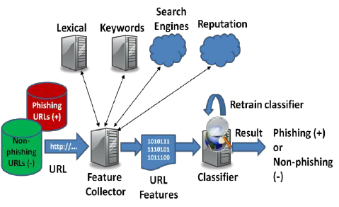
DESIGN OF PROPOSED MODEL

Slide 7
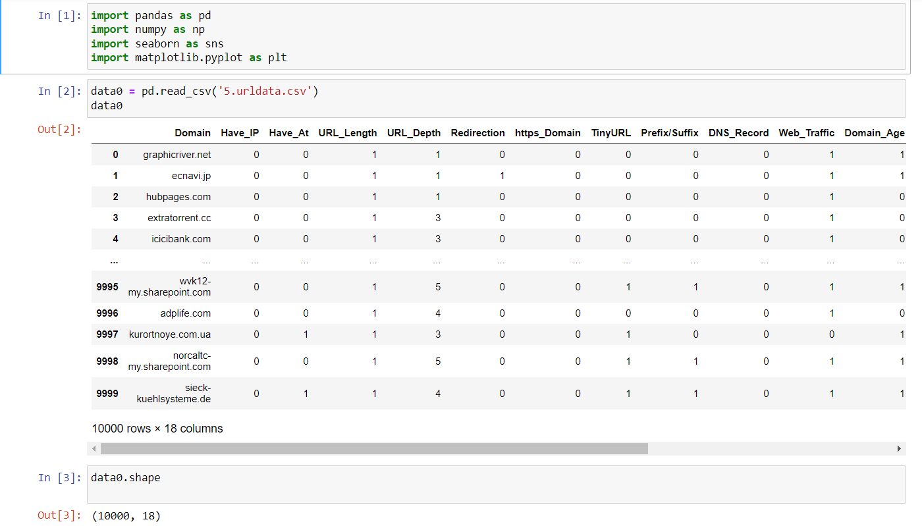
MODEL EVALUATION / EXECUTION

Slide 8
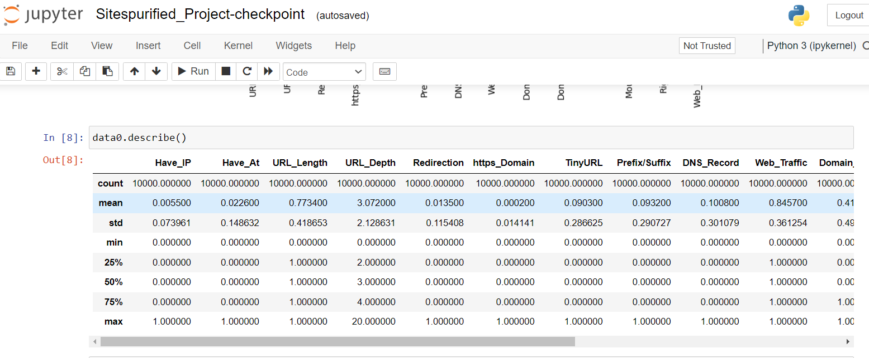
MODEL EVALUATION / EXECUTION

Slide 9
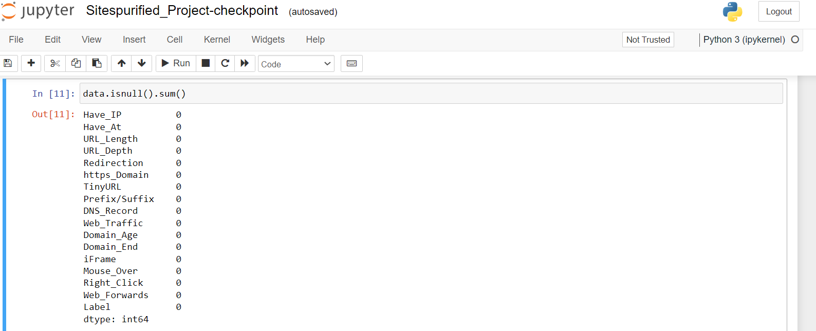
MODEL EVALUATION / EXECUTION

Slide 10
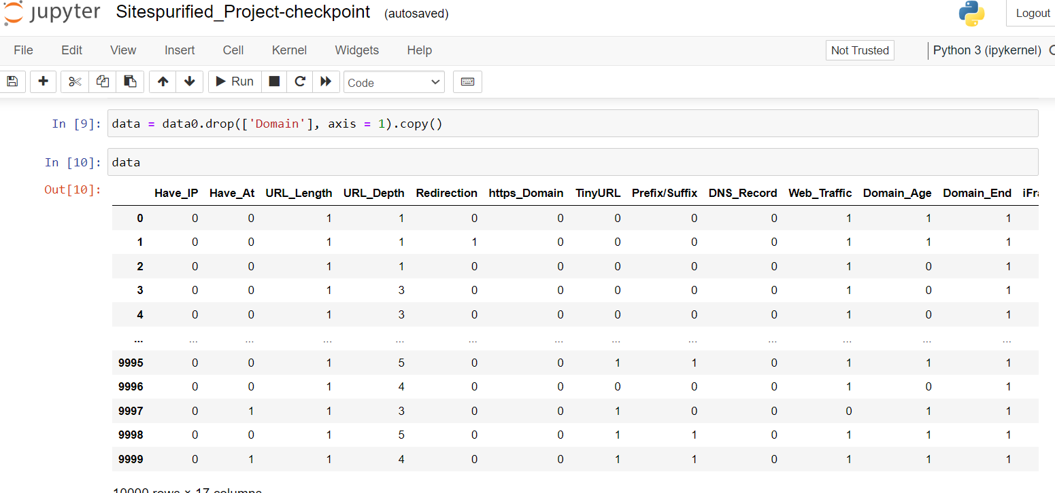
MODEL EVALUATION / EXECUTION

Slide 11
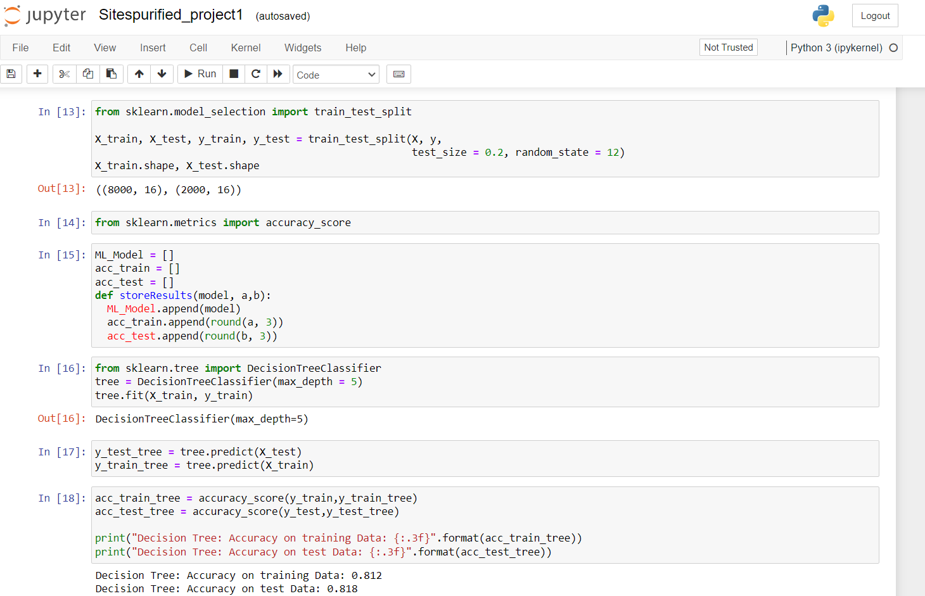
MODEL EVALUATION / EXECUTION

Slide 12
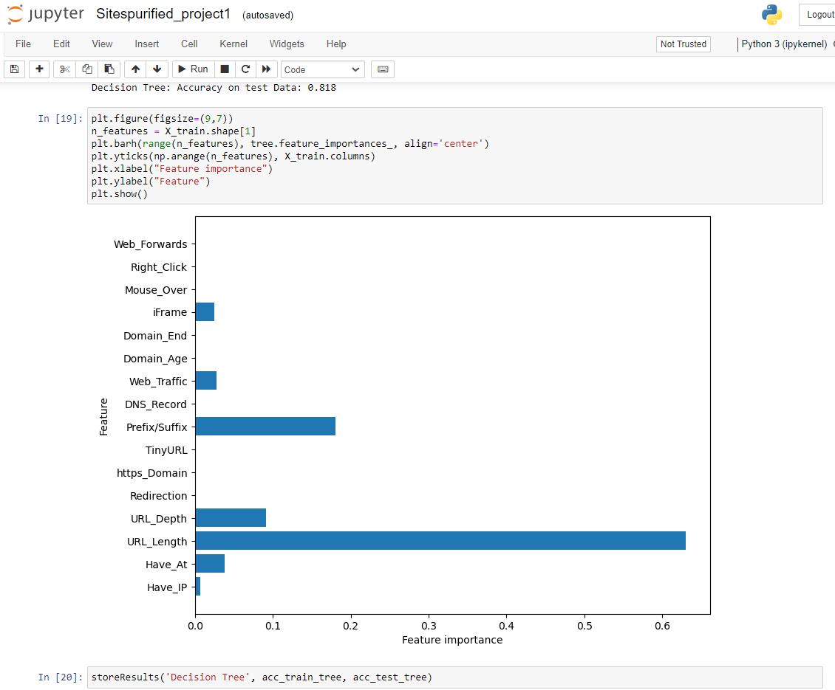
MODEL EVALUATION / EXECUTION

Slide 13
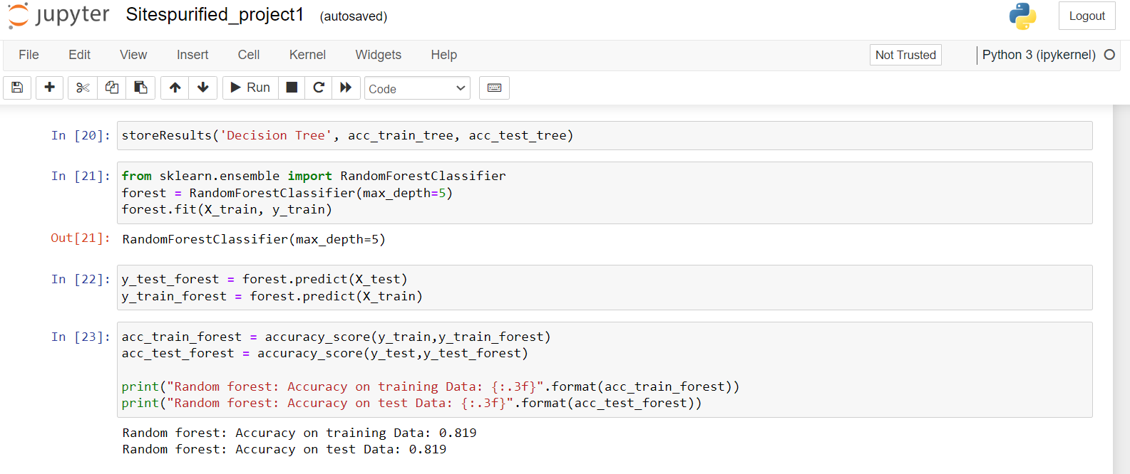
MODEL EVALUATION / EXECUTION

Slide 14
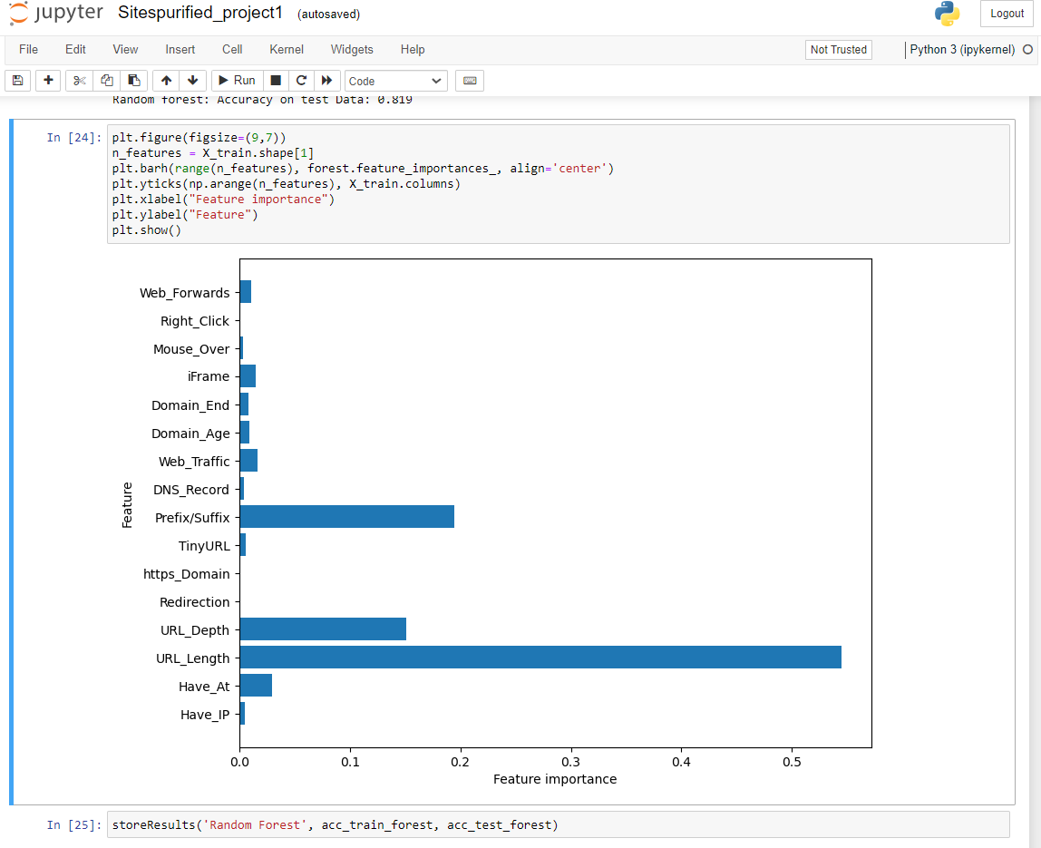
MODEL EVALUATION / EXECUTION

Slide 15
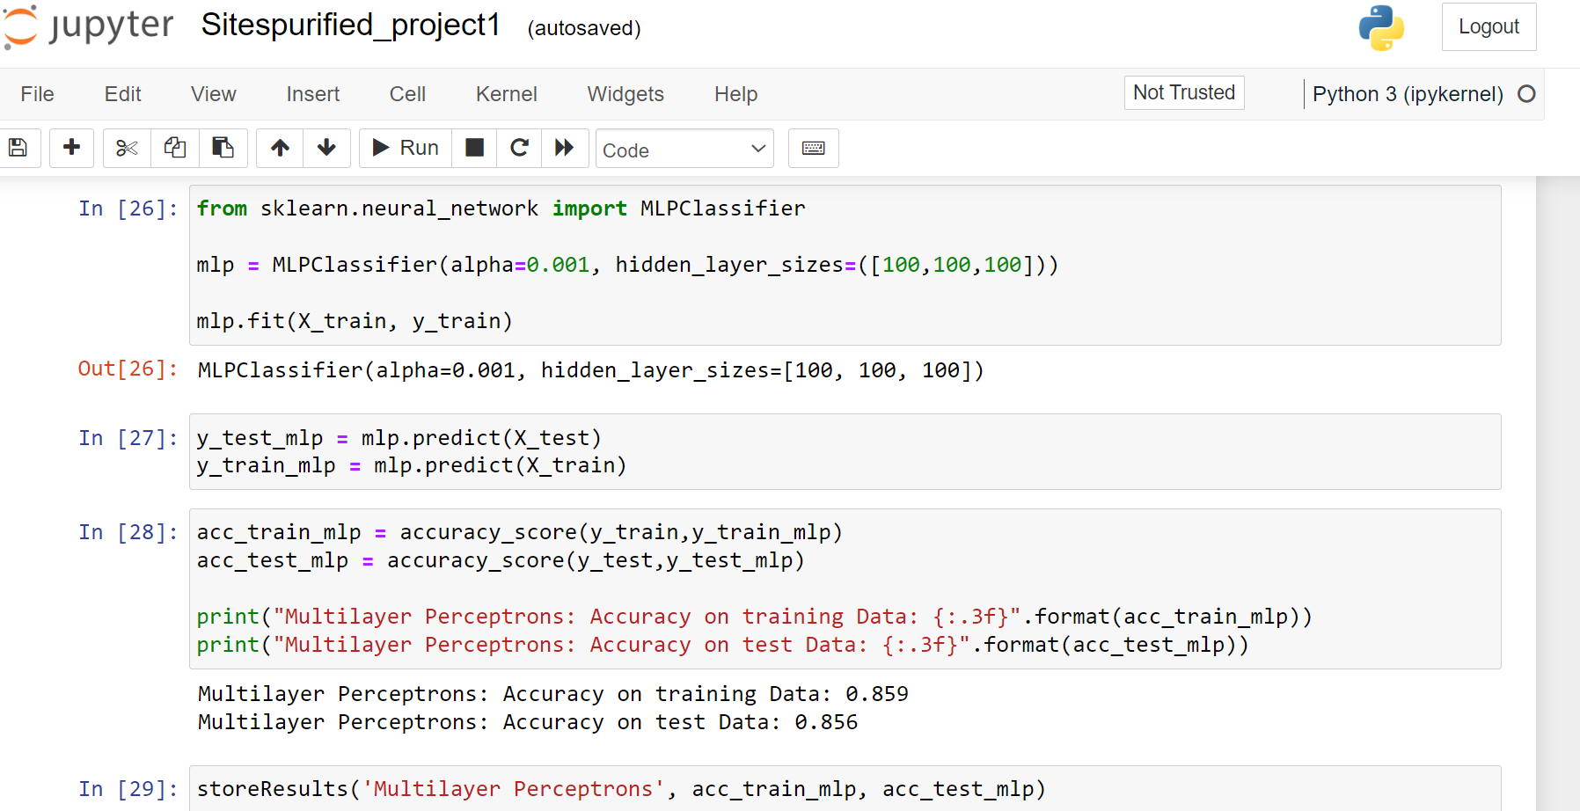
MODEL EVALUATION / EXECUTION

Slide 16
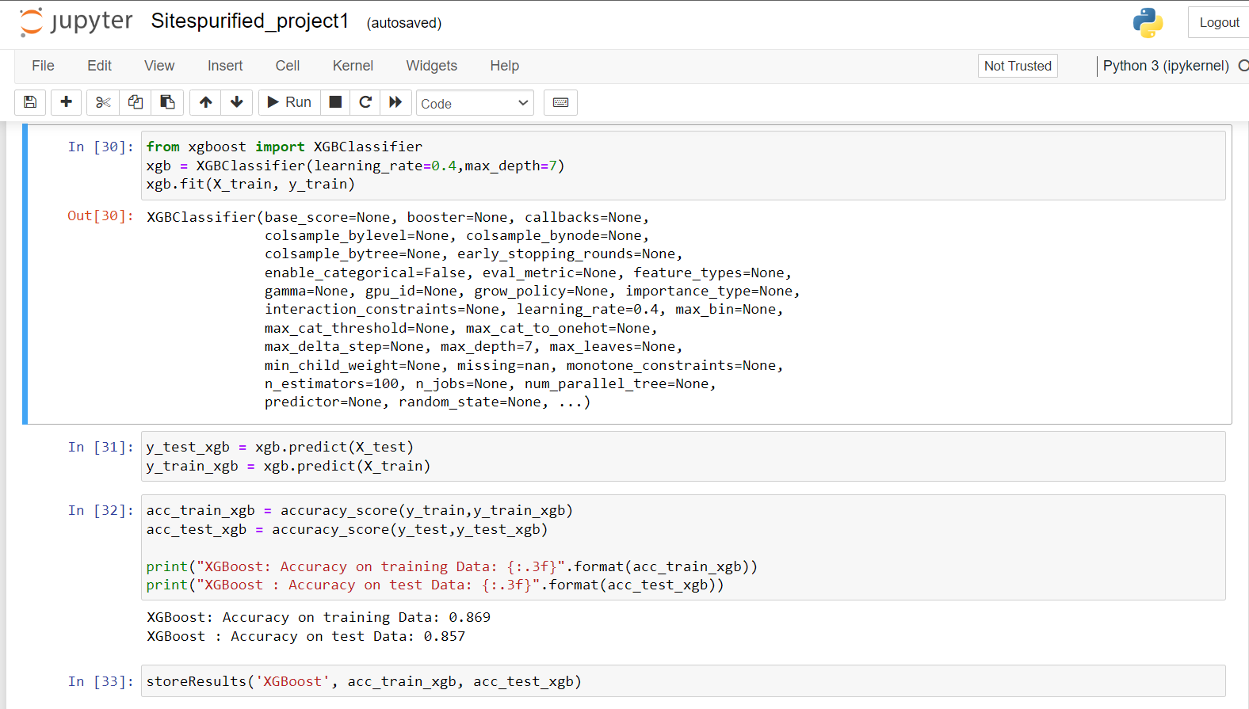
MODEL EVALUATION / EXECUTION

Slide 17
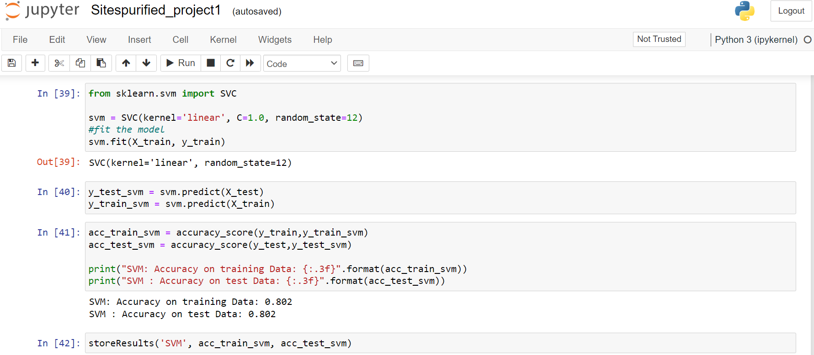
MODEL EVALUATION / EXECUTION

Slide 18
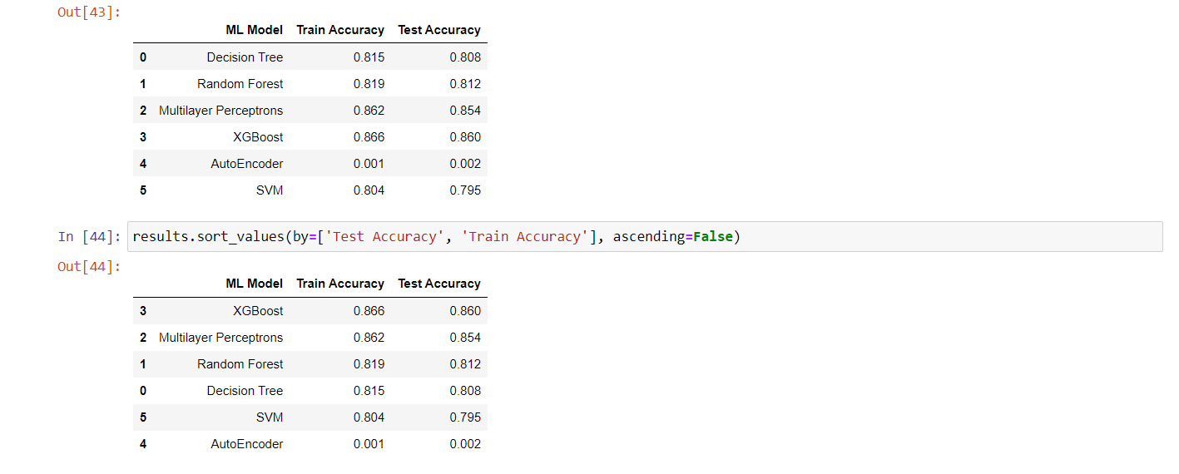
MODEL EVALUATION / EXECUTION

Slide 19
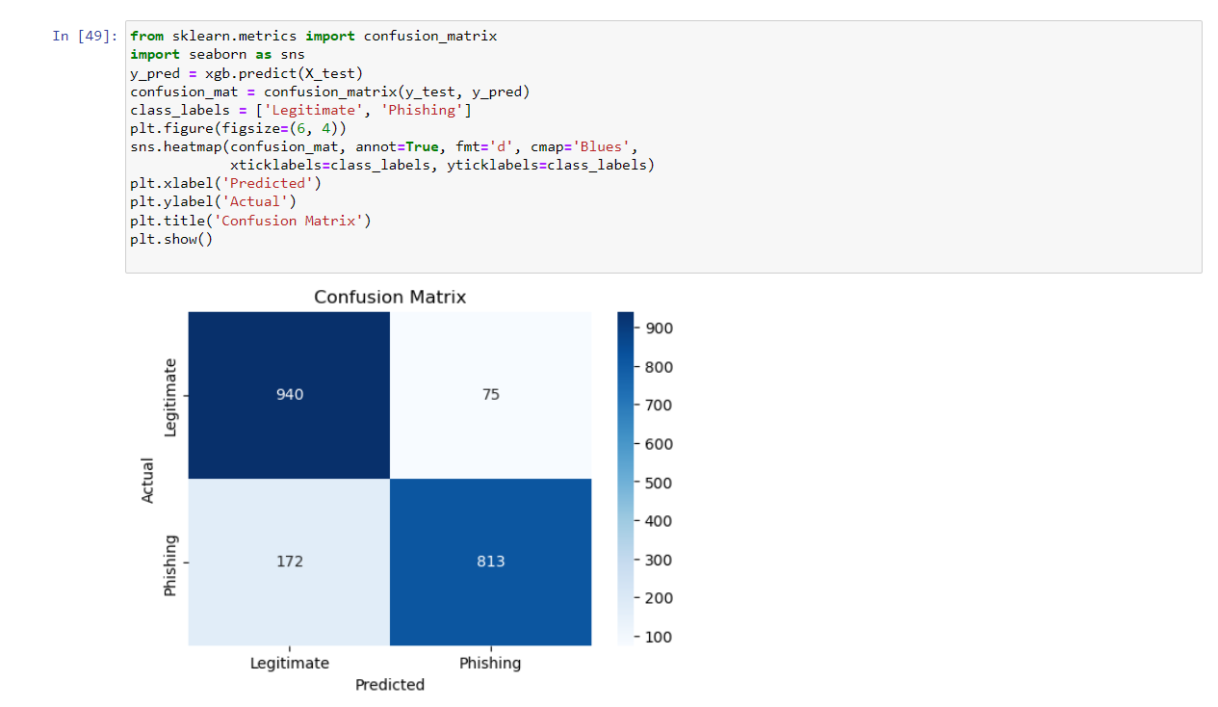
MODEL EVALUATION / EXECUTION

Slide 20
CASE STUDY
“ Detection of Phishing Website Campaign Targeting Online Banking Customers “
DESCRIPTION : In this case study, the phishing website detector was employed to analyze and detect a targeted phishing campaign aimed at online banking customers. The study focused on identifying fraudulent websites designed to mimic legitimate banking portals and extract sensitive user information.
METHODOLOGY : The phishing website detector utilized machine learning algorithms and feature analysis to differentiate between genuine banking websites and phishing websites.
RESULTS : By leveraging the developed model, the security team was able to promptly identify and block the fraudulent URLs, preventing potential financial losses and unauthorized access to customer accounts.
IMPACT :Overall, this case study highlights the significance of the phishing website detector in combating targeted phishing campaigns, protecting customers' financial information, mitigating identity theft risks, preserving customer trust, enhancing operational efficiency, and ensuring the adaptability of the detection system to evolving threats.

Slide 21
CONCLUSION
In conclusion, the development of the phishing website detector project has demonstrated the effectiveness of machine learning techniques in detecting and mitigating phishing attacks.
By utilizing advanced algorithms and feature analysis, the detector showcased accurate identification of phishing websites, thereby protecting users from potential financial losses, identity theft, and unauthorized access to sensitive information.
The project's performance evaluation, including metrics such as accuracy, indicated promising results.
The detector exhibited a high level of accuracy and demonstrated the ability to differentiate between legitimate and fraudulent websites.
Overall, the project's successful development and evaluation underscore the importance of continued research and innovation in phishing website detection.

Slide 22
FUTURE WORK
As part of the future work, we intend to develop a Streamlit application to enhance the accessibility and usability of our phishing website detector.
The integration of a Streamlit application will provide a user-friendly interface where users can easily interact with the detector, input URLs or web content for analysis, and receive immediate results
The application will allow users to have a more intuitive and interactive experience, improving the overall usability of the phishing website detector.
Additionally, it will enable users to quickly assess the credibility of websites and make informed decisions to protect themselves from phishing attacks.
By leveraging the power of Streamlit, we aim to provide a seamless and efficient user experience while ensuring the accuracy and reliability of the phishing website detection process.

Slide 23
REFERENCES / BIBLIOGRAPHY
Dang, V. H., & Liew, S. C. (2020). Phishing websites detection using machine learning techniques. In 2020 IEEE International Conference on Artificial Intelligence and Computer Applications (ICAICA) (pp. 1-6). IEEE.
Ramachandran, G., & Kumaraguru, P. (2018). PhishAri: Automatic real-time phishing detection on Twitter. In Proceedings of the 2018 World Wide Web Conference (pp. 817-826). International World Wide Web Conferences Steering Committee.
Sengupta, S., & Mazumdar, S. (2020). Phishing website detection using machine learning classifiers and feature selection. In 2020 International Conference on Advances in Computing, Communication Control and Networking (ICACCCN) (pp. 1-6). IEEE.
Kumar, M., et al. (2020). Phishing URL Detection Using Deep Learning Technique. In Proceedings of the International Conference on Advanced Computing and Intelligent Engineering (pp. 451-459). Springer.

Slide 24
THANK YOU

